Slide 1

Chapter 12 Part 2
Distributed Database
Management Systems
The slides in this presentation have been adapted from slides provided with the textbook, Database Systems: Design, Implementation, and Management,
12E, Cornel and Morris, Copyright © 2017 Cengage Learning.

Slide 2
Learning Objectives
How transactions are managed in a distributed database environment
How distributed database design draws on data partitioning and replication to balance performance, scalability, and availability
Copyright © 2017 Cengage Learning
2

Slide 3
Distributed Requests and Distributed Transactions
Remote request
Remote transaction
Distributed transaction
Distributed request
Single SQL statement accesses data processed by a single remote database processor
Accesses data at single remote site composed of several requests
Requests data from several different remote sites on network
Single SQL statement references data at several DP sites
Copyright © 2017 Cengage Learning
3

Slide 4
Distributed Concurrency Control
Concurrency control is especially important in distributed databases environment
Multi-site, multiple-process operations are more likely to create inconsistencies and deadlocked transactions
Solution to inconsistent database is a two-phase commit protocol
Copyright © 2017 Cengage Learning
4

Slide 5
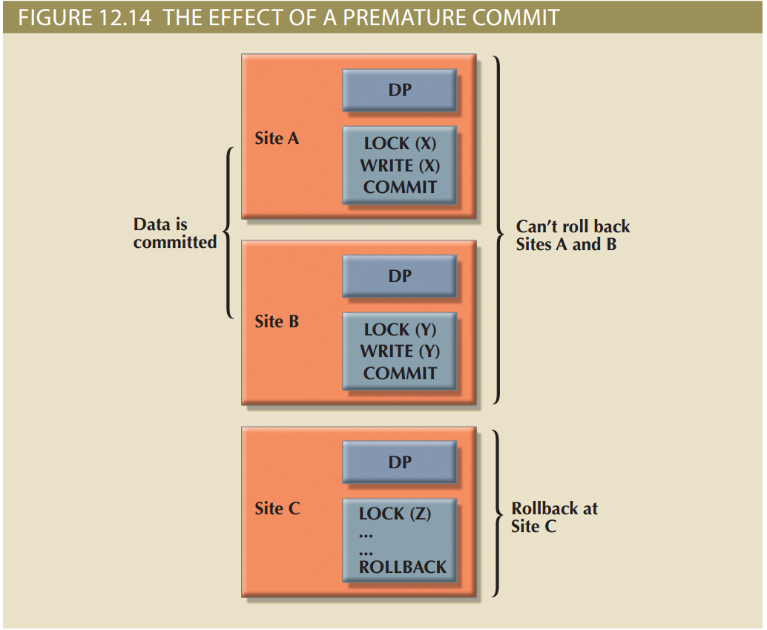
Figure 12.14 - The Effect of Premature COMMIT
Copyright © 2017 Cengage Learning
5

Slide 6
Two-Phase Commit Protocol (2PC)
Guarantees if a portion of a transaction operation cannot be committed, all changes made at the other sites will be undone
To maintain a consistent database state
Requires that each DP’s transaction log entry be written before database fragment is updated
DO-UNDO-REDO protocol: Roll transactions back and forward with the help of the system’s transaction log entries
Copyright © 2017 Cengage Learning
6

Slide 7
Two-Phase Commit Protocol (2PC)
Write-ahead protocol: Forces the log entry to be written to permanent storage before actual operation takes place
Defines operations between coordinator and subordinates
Phases of implementation
Preparation
The final COMMIT
Copyright © 2017 Cengage Learning
7

Slide 8
Performance and Failure Transparency
Performance transparency: Allows a DDBMS to perform as if it were a centralized database
Failure transparency: Ensures the system will operate in case of network failure
Considerations for resolving requests in a distributed data environment
Data distribution
Data replication
Replica transparency: DDBMS’s ability to hide multiple copies of data from the user
Copyright © 2017 Cengage Learning
8

Slide 9
Performance and Failure Transparency
Network and node availability
Network latency: delay imposed by the amount of time required for a data packet to make a round trip
Network partitioning: delay imposed when nodes become suddenly unavailable due to a network failure
Copyright © 2017 Cengage Learning
9

Slide 10
Distributed Database Design
Data fragmentation
How to partition database into fragments
Data replication
Which fragments to replicate
Data allocation
Where to locate those fragments and replicas
Copyright © 2017 Cengage Learning
10

Slide 11
Data Fragmentation
Breaks single object into many segments
Information is stored in distributed data catalog (DDC)
Strategies
Horizontal fragmentation: Division of a relation into subsets (fragments) of tuples (rows)
Vertical fragmentation: Division of a relation into attribute (column) subsets
Mixed fragmentation: Combination of horizontal and vertical strategies
Copyright © 2017 Cengage Learning
11

Slide 12
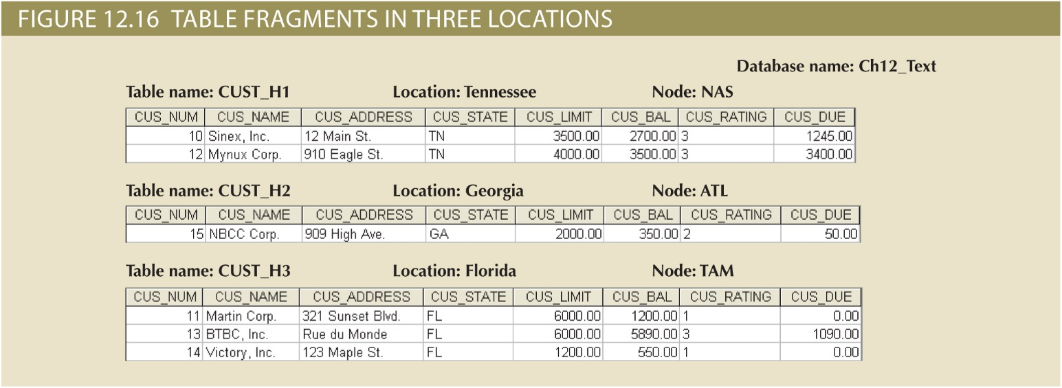
Copyright © 2017 Cengage Learning
12

Slide 13
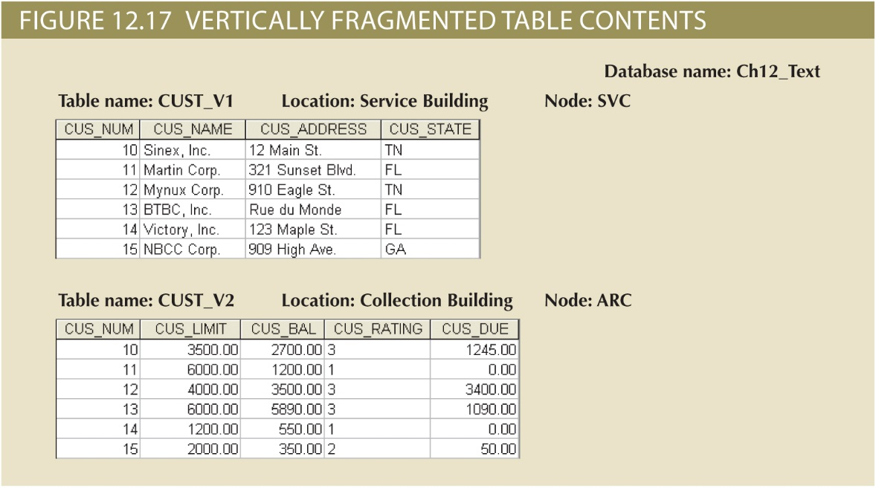
Copyright © 2017 Cengage Learning
13

Slide 14
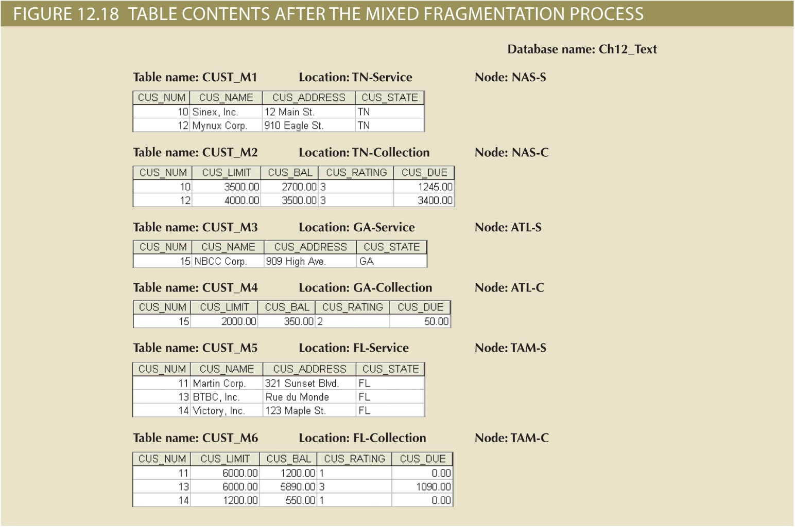
Copyright © 2017 Cengage Learning
14

Slide 15
Data Replication
Data copies stored at multiple sites served by a computer network
Mutual consistency rule: Replicated data fragments should be identical
Styles of replication
Push replication
Pull replication
Helps restore lost data
Copyright © 2017 Cengage Learning
15

Slide 16
Data Replication Scenarios
Fully replicated database
Stores multiple copies of each database fragment at multiple sites
Partially replicated database
Stores multiple copies of some database fragments at multiple sites
Unreplicated database
Stores each database fragment at a single site
Copyright © 2017 Cengage Learning
16

Slide 17
Data Allocation Strategies
Centralized data allocation
Entire database stored at one site
Partitioned data allocation
Database is divided into two or more disjoined fragments and stored at two or more sites
Replicated data allocation
Copies of one or more database fragments are stored at several sites
Copyright © 2017 Cengage Learning
17

Slide 18
The CAP Theorem
CAP stands for:
Consistency
Availability
Partition tolerance
Basically available, soft state, eventually consistent (BASE)
Data changes are not immediate but propagate slowly through the system until all replicas are consistent
Copyright © 2017 Cengage Learning
18

Slide 19
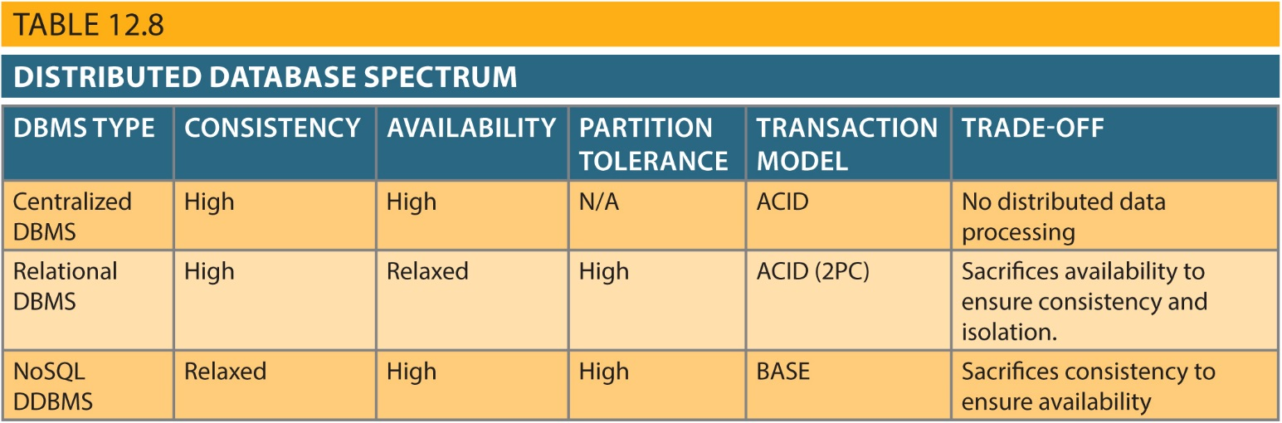
Table 12.8 - Distributed Database Spectrum
Copyright © 2017 Cengage Learning
19

Slide 20
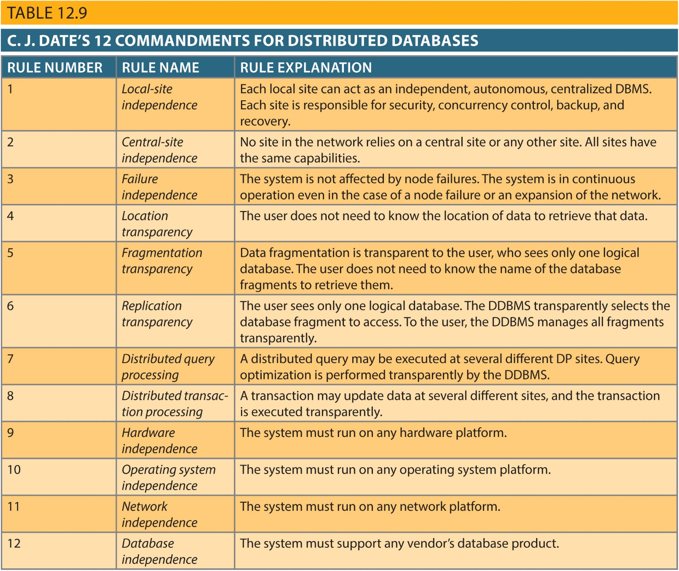
Copyright © 2017 Cengage Learning
20

Slide 21
Distributed Database Transparency Features
Distribution transparency
Transaction transparency
Failure transparency
Performance transparency
Heterogeneity transparency
Copyright © 2017 Cengage Learning
21

Slide 22
Distribution Transparency
Allows management of physically dispersed database as if centralized
Levels
Fragmentation transparency
Location transparency
Local mapping transparency
Copyright © 2017 Cengage Learning
22

Slide 23
Distribution Transparency
Unique fragment: Each row is unique, regardless of the fragment in which it is located
Supported by distributed data dictionary (DDD) or distributed data catalog (DDC)
DDC contains the description of the entire database as seen by the database administrator
Distributed global schema: Common database schema to translate user requests into subqueries
Copyright © 2017 Cengage Learning
23

Slide 24
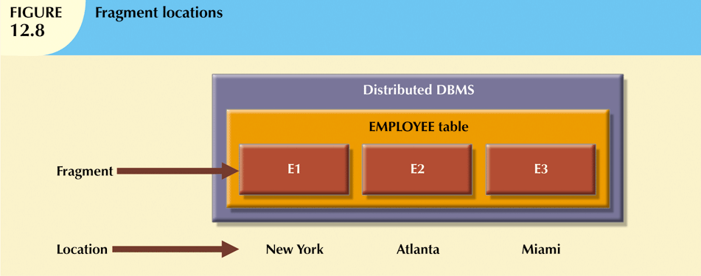
Fragment and Location
Transparency
Copyright © 2017 Cengage Learning
24

Slide 25
Transaction Transparency
Ensures database transactions will maintain distributed database’s integrity and consistency
Ensures transaction completed only when all database sites involved complete their part
Distributed database systems require complex mechanisms to manage transactions
Copyright © 2017 Cengage Learning
25

Slide 26
Summary
Homogeneous distributed database system
Integrates one type of DBMS over computer network
Heterogeneous distributed database system
Integrates several types of DBMS over computer network
The design of distributed database must consider fragmentation and replication of data
Horizontal and vertical fragmentation
Copyright © 2017 Cengage Learning
26

Slide 27
Task
Define BASE and explain when it is an acceptable approach for DB consistency.
Copyright © 2017 Cengage Learning
27

